Slide 1
How can CarMax improve their NPS?
INFO 320: Group 3
Carla Quinteros, Bethany Garber, Mia Nguyen, Josh Sandoval
Notes:
Hi everyone, we are Group 3 and this is our presentation for CarMax’s Net Promoter Score improvement strategy

Slide 2
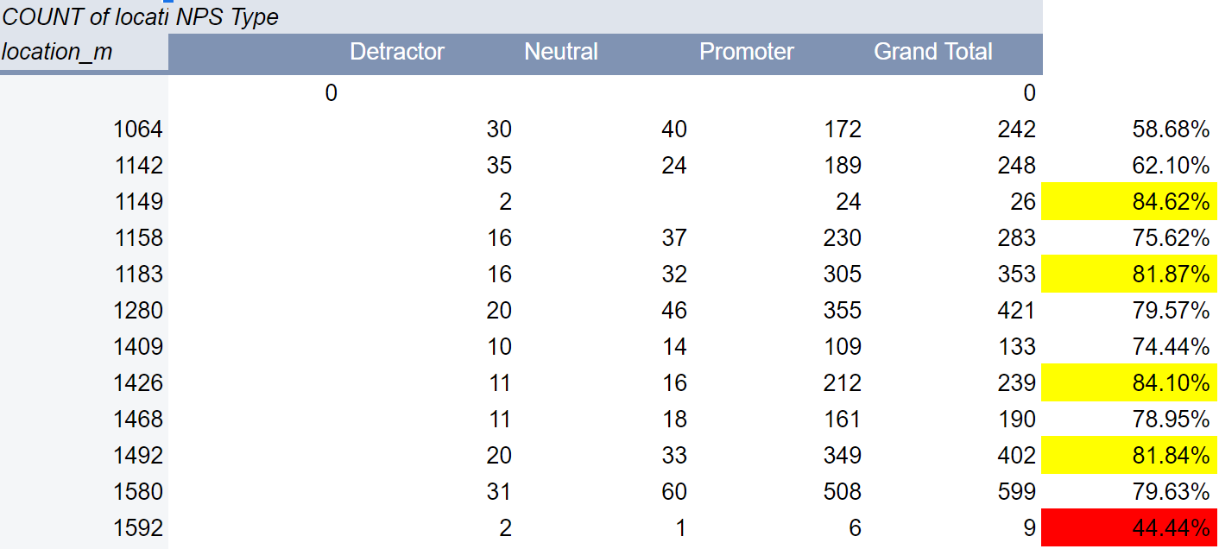
Notes:
On this slide we have a section of a pivot table comparing Carmax locations and their nps scores. As seen highlighted in red, store 1592 has a very low nps score in comparison to others, while the locations with scores highlighted in yellow have higher NPS scores. It would be worthwhile to investigate the highlighted stores to see what they might be doing to stand out from the rest.

Slide 3
NPS Scores by Location
Stores 5694, 4592, and 4341 have excellent NPS scores
What are they doing to improve customer experience?
Stores 1592 and 9694 have very poor NPS scores
What is causing these low scores?
Notes:
Stores 5694, 4592, and 4341 had the highest overall nps scores out of all carmax locations. What are these stores doing to stand out above the rest? Do they have more staff? Are they pushing promotions more, or less? We should learn what this store is doing differently than others, and move on to implement it into other stores nationwide. Stores 1592 and 9694 had very poor NPS scores. What are these stores doing to yield such low scores? Are they in bad areas? Do they need to be shut down? Much can be learned from visiting these stores.

Slide 4
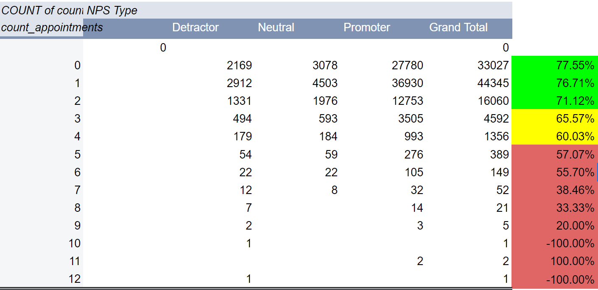
Notes:
On this slide we have a pivot table comparing amount of appointments to NPS score. As seen in the green, yellow, and red to the right, NPS score tends to go down as a customer has to make more appointments. This data point should be taken into consideration by carmax analysts as to not worry so much on making numerous appointments with customers but rather learn to build meaningful relationship with the customer during fewer appointments.

Slide 5
NPS Scores per Number of Appointments
More appointments = Low NPS Score
Focus on getting it right the first time
Less appointments per day, give customers more time
Notes:
According to our observations, more appointments makes for a lower nps score. Our theory is that if a customer has to make more appointments, they may be having trouble finding the right vehicle for them. They get inundated with information that analysis paralysis kicks in. Therefore, we should focus on satisfying the customer on their first visit. It would be wise to schedule less appointments per day, and give customers as much time as they need to ask questions, test drive, and find their perfect fit.

Slide 6
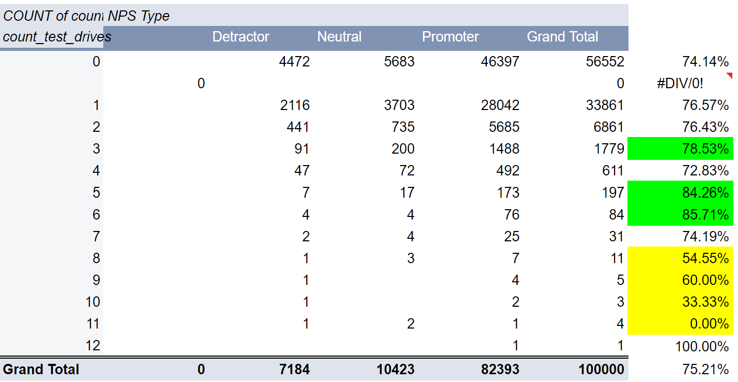
Notes:
Finally, we have our pivot table comparing test drives and NPS score. Customers who go on anywhere from one to seven test drives tend to have solid NPS scores, but this begins to see a decrease at eight test drives. However, there are still more promoters at 8 test drives than there are detractors. We can also see that the highest NPS scores came from customers who went on 3, 5, and 6 test drives.

Slide 7
NPS Scores per Number of Test Drives
Minimizing test drives
Find the customer’s perfect vehicle in 7 test drives
Per each test drive…
What went good?
What went bad?
Notes:
Our theory is that customers who approach 8 test drives may be having a hard time finding a vehicle. Therefore, we should aim to find their perfect match in 7 test drives. Per each test drive, we should thoroughly work out their pros and cons with each vehicle in order to lead us in the right path. Did they like the interior? Did it drive well for them? Is there enough leg room? Should any of these questions result in a “no”, we should attempt to find a car that will make them say “yes”

Slide 8
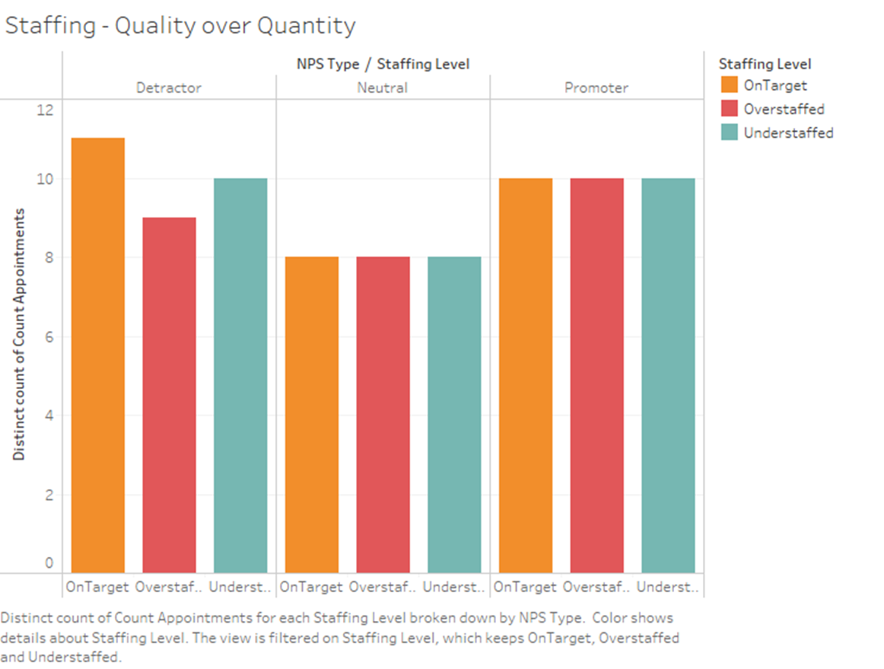
Staffing level does not make an overwhelming difference on NPS type during appointments.
Notes:
Next, we have our Tableau visualization. Per the visualization, the level of staffing does not have an impact on the NPS score. Whether the staffing at an individual store is under the usual amount or below the usual amount, NPS score remain unperturbed. This has lead us to believe that the quality of the effort that an employee is outputting is more efficient than the quantity of employees present during an appointment.

Slide 9
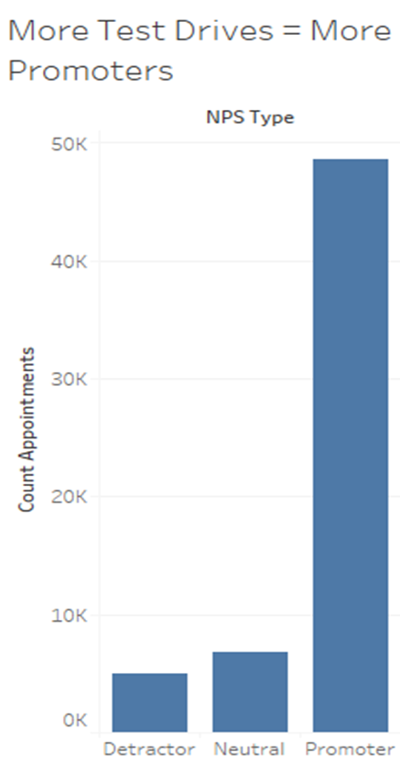
More customers who are promoters are taking test drives
Notes:
As evident from an analysis in Tableau, the customers that have taken test drives have been shown to recommend Carmax and their experience to a close friend. The customers who have a NPS score of 8 and above has a huge correlation with the amount of test drives taken. The amount of promoters is 10x the amount of detractors. Analysts at Carmax should take this data point into consideration when considering increasing net promoter score.

Slide 10
Conclusion
Analyze customers likes and dislikes about vehicles to lessen test drives and create a better, more attentive experience
Booking less appointments and increasing how long the appointments last.
Visit stores with high NPS scores and low NPS scores to figure out what is making the difference between promoters and detractors
Notes:
We can conclude that in order to improve their Net Promoter Scores, CarMax needs to analyze their customers’ opinions about their likes and dislikes for cars in order to create a more attentive experience. Look into how the test drive was conducted and further ease the experience into test drives. The minute a customer walks into the store, it would be a great benefit to keep in mind the idea of “How can I get them to test drive”. They should book less appointments and increase the appointment time. The quality of an individual experience should supercede how many individual experience are had in a given time. Lastly, they should visit other stores with varying NPS scores to better understand what the differences are between promoting and detracting customers. When comparing a store that has a low NPS score and a store that has a high NPS score, learn the business models that are being ran. What is the key feature that the high NPS store has that the low NPS store doesn’t.

